Slide 1
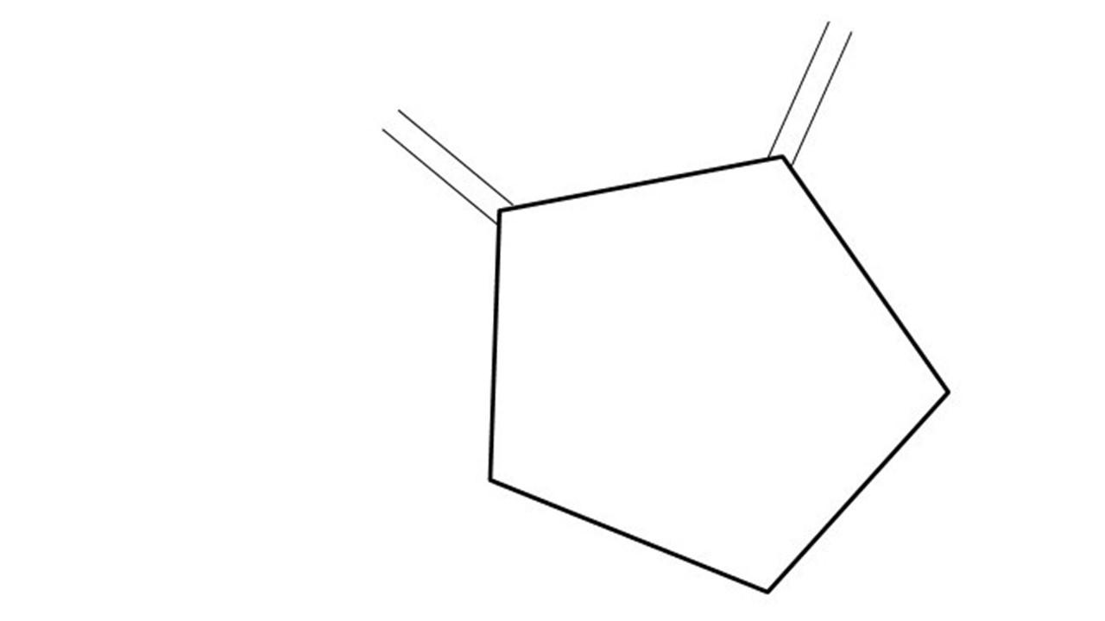
Great Cow BASIC Part 3
Great Cow BASIC for the PIC16F171xx chip Family
Oct 2022

Slide 2
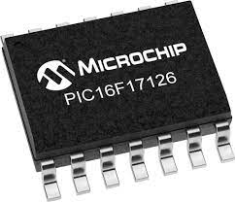
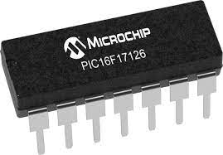
PIC16F17126
PIC16F171xx is a high performance PIC16
Digital and Analog peripherals
12-bit ADC
Multiple communication interfaces
Serial, I2C, SPI
PWM – CCP/PWM and 16Bit
Configurable Logic Cells
OpAmp
The PIC16F171xx offers 8 to 20 pin products in small footprint packages to support customers in a variety of space constrained and sensor node applications.

Slide 3
Videos...
Install the hardware and make the board work – three LED programs
Make four LEDs flash in a sequence
Set the LEDs to represent the value of ADC
Sequence the LEDs with a delay using the value of ADC
Using an input to set the state of the LEDs
Using the reset switch
Using the switch, ADC – may the LEDs flash in a sequence with reverse
Using the serial to display values
Using the timer0 overflow, 8bit timer, 16bit timer to flash the LEDs
Using CCP/PWM to dim the LEDS
Using I2C with serial to discover I2C devices
Using EEProm – showing values on the serial terminal
Using an I2C GCLD display
Using an SPI GCLD display
Using PWM to dim the LEDS
Using memory within the PIC – Progmem and SAF memory
The Great Cow BASIC tool chain
Assembly and alternatives assemblers
Summary

Slide 4
Great Cow BASIC Compiler
Great Cow BASIC is an Open Source compiler for Microchip PIC & AVR and LGT microcontrollers
Great Cow BASIC now supports the 16F17126 chip family
Great Cow BASIC Compiler

Slide 5

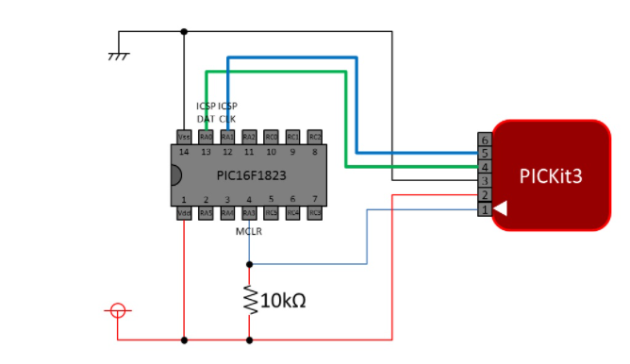
Microcontroller connectivity
PIC16F17126

Slide 6
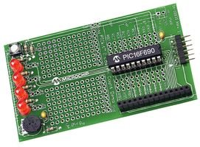
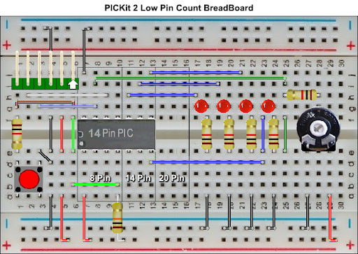

Hardware
Microchip Low Pin Count Demo Board
PICKit_2_Low_Pin_Count_User_Guide_51556a.pdf
By Chris Roper

Slide 7
Analog-to-Digital
An analog-to-digital converter (ADC, A/D, or A-to-D) is a system that converts an analog signal, such as a setting of a potentiometer, sound picked up by a microphone or light entering a digital camera, into a digital signal.
We will configure the ADC on the 16F17126 run a conversion, read the analog voltage controlled by the potentiometer on the board, and display the results on the LEDs.

Slide 8
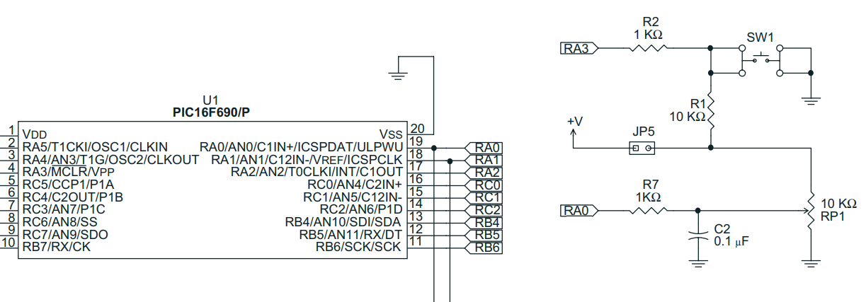
Analog-to-Digital
Using ANA0 connected to RA0 (PortA.0)

Slide 9
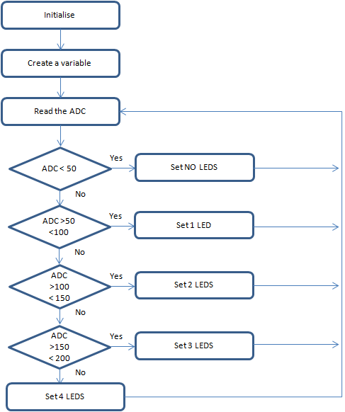
Analog-to-Digital
Great Cow BASIC completes the initialisation
We need to create a variable to store the ADC results
Read the ADC
Great Cow BASIC makes the process easy via the ReadADC()
ReadADC returns a value of 0 to 255
Set the LEDs
Wait 100 ms
Do it step 2 again

Slide 10
Analog-to-Digital

Slide 11
Lab
Examine the sample code and review the results
More insights into GCStudio
IntelliSense and Help
Changing the Default Settings
PICInfo – the tool to understand the microcontroller

Slide 13
Videos...
Install the hardware and make the board work – three LED programs
Make four LEDs flash in a sequence
Set the LEDs to represent the value of ADC
Sequence the LEDs with a delay using the value of ADC
Using an input to set the state of the LEDs
Using the reset switch
Using the switch, ADC – may the LEDs flash in a sequence with reverse
Using the serial to display values
Using the timer0 overflow, 8bit timer, 16bit timer to flash the LEDs
Using CCP/PWM to dim the LEDS
Using I2C with serial to discover I2C devices
Using EEProm – showing values on the serial terminal
Using an I2C GCLD display
Using an SPI GCLD display
Using PWM to dim the LEDS
Using memory within the PIC – Progmem and SAF memory
The Great Cow BASIC tool chain
Assembly and alternatives assemblers
Summary

Slide 14
Great Cow BASIC
Great Cow BASIC for the PIC16F17126 chip Family
Oct 2022

Slide 15
Backup Slides

Slide 16
Initialise
Create a variable
Read the ADC
Wait 100 ms
ADC < 50
Yes
Set NO LEDS
No
ADC >50 <100
Yes
Set 1 LED
No
ADC >100
< 150
Yes
Set 2 LEDS
No
ADC >150
< 200
Yes
Set 3 LEDS
No
Set 4 LEDS

Slide 17
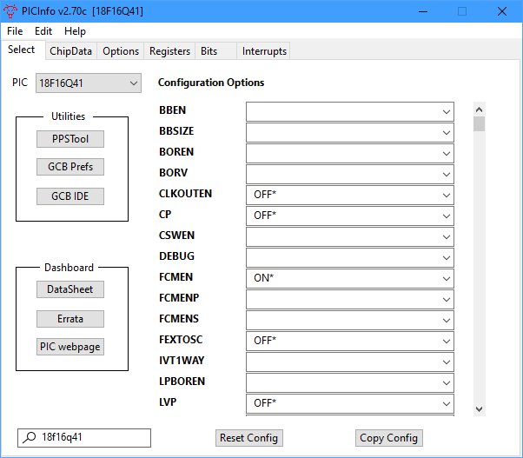
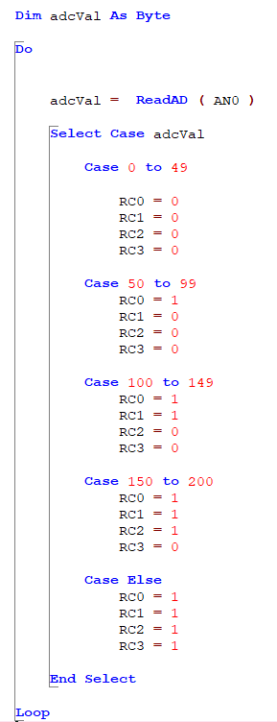
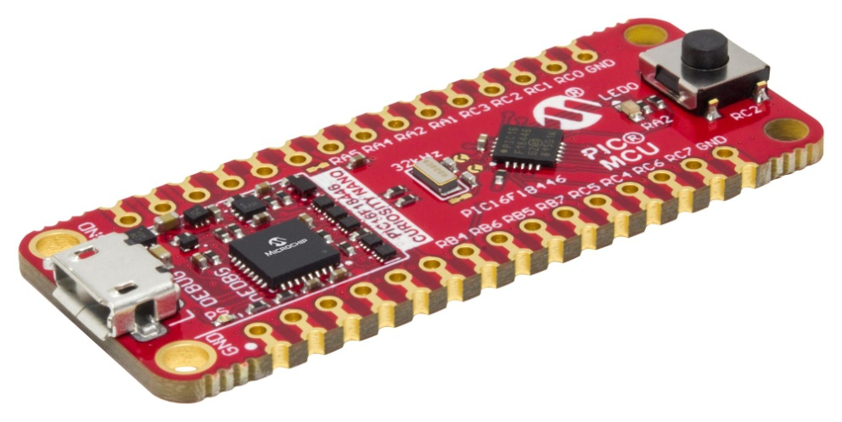
Analog-to-Digital

